Slide 1
Representation Learning
Week 8

Slide 2
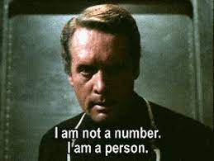
What Our Datum Really Is
A datum of interest is typically something in the real world
A physical object
A place
A user
An idea

Slide 3
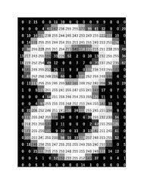
Numerical Representation
Computers don’t see the real data
Computers see numbers
Use numbers represent the real datum
Simplest example: use raw observarional data
Pixels
Point clouds
Letters

Slide 4
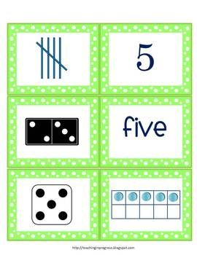
Countless Representations
There are many way to represent the same daum
In fact, infinite ways
How do we select the best one?
What are the criteria for a good representation?
Notes:
What are the criteria for a good representation? – The big question.

Slide 5
Mathematical Formulation
A procedure such that:
for every data point x, we have vector e that represents it
Very general
Can map every x to 0
Can map each x to a different random number
Procedure is not neccesarily a parametric function
Need more constraints…
Notes:
We are looking for a procedure to take any data and output a representation. This procedure is very general, so we need to add more constraints..
Sparse representation – not many concepts activated in data (more of a side note, not specific to this slide)

Slide 6
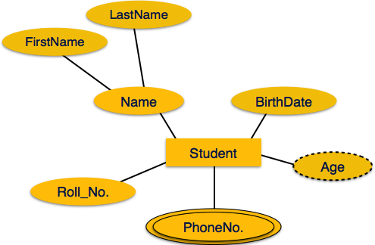
Information Preservation
Representation should present the important information
What’s imporant?
Option 1: Everything
Option 2: Only the semantic aspects
What’s semantic?
Notes:
We know how to measure distance (L1,L2,etc) but we need to define what does “similar” and “interesting” mean.
We want a representation that will keep information as much as possible. On the other hand, may be redundant, some information can be harmful (examples in the rest of the lecture).

Slide 7
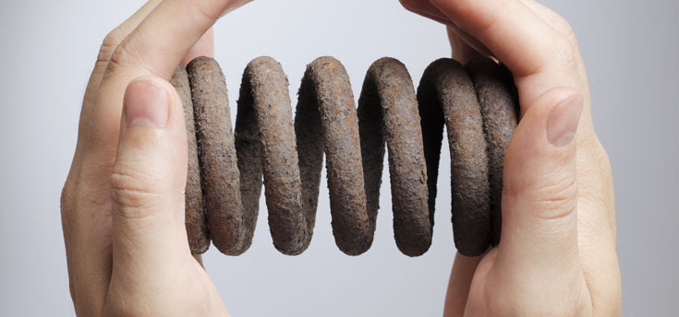
Low-dimension
We often want a compact representation
Like compression – there is a tradeoff
Low dimension - high compression – high information loss
High dimension - low compression – low information loss

Slide 8
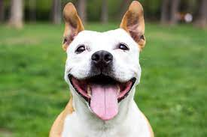
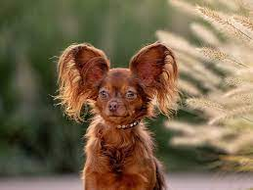
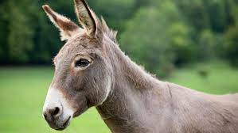
Meaningful Distance on Semantic Attributes
Assume there is a set of attributes we care about
Does low (l1,l2,cosine) distance = similar value of semantic attributes?
Notes:
We want distance to match our semantic attributes (task dependent).

Slide 9

Informativeness on Semantic Attributes
Assume there is a set of attributes we care about
Can linear classifier predict attribute values?
Notes:
The difference is that in the last slide we wanted distance. In this slide we want to learn a linear function to taker us from the representation to desired attributes.
This is easier because distance can be tricky when using distance (if we look at animals, and attributes are color and species for example).

Slide 10
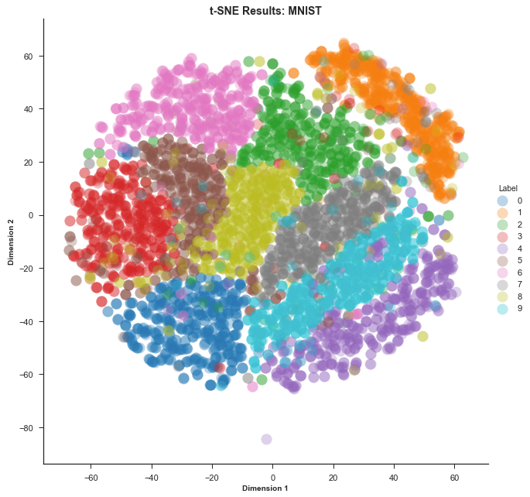
Visualization
Can we easily visualize the representation?
Typically means:
2D representation
Distance corresponds to semantic attributes
Notes:
Probably there isn’t a single representation for every criterion, so we need to prioritize.

Slide 11

Pretraining – Not Really RL
In DL –preliminary training stage on large, but unrelated dataset
A good starting point for training on our target dataset
Not really representation learning
Often confused together

Slide 12
Classical Machine Learning Ideas
Traditional literature:
Reducing dimension
Preserving as much information as possible
Challenge: measuring how much important information is preserved

Slide 13
Distance Preservation: Schema
Calculate distance between each pairs of samples d_{ij} = d(x_{i},x_{j})
Come up with embeddings for each point e.g. e_{i} for xi
Distances between embeddings and samples should be similar
Notes:
We still need to define what is similar.

Slide 14
Simple Case: Classical Dimensional Scaling
Measure distance between sample pairs using L2
Measure distance between embedding pairs using L2
Minimize difference between distances
We will show this is equivalent to PCA

Slide 15
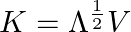
cMDS = PCA
Assume then if the embeddings have mean 0,
or in matrix notation:
As we can write:
We have:
Notes:
Last equation should be E instead of K.

Slide 16
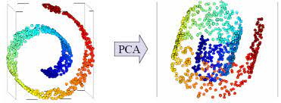
So What’s Wrong with PCA
Several issues:
A linear function – not powerful enough for complex data
More influence by large distances than small ones
Clusters are separated but local structure not preserved
Notes:
In this case, keeping Euclidean distance is less relevant, in this case, for example a blue point should be far away from a yellow one. So PCA will preserve the original distance,
But we want the embedding to represent based on its “true” distance.

Slide 17
Local Embedding Methods
Let’s reconsider the swiss roll
Data lies on a 2D manifold
How to describe it’s geometry?
Idea: local structure!
Notes:
Data lies on a 2D manifold – can be too hard of an assumption

Slide 18
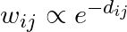
Laplacian Eigenmaps
For each point x_{i} find its k NNs
For each NN j, compute weight
Learn embedding ei for each xi such that
Constraint is in theory a little more complex
Constraint ensures solution does not collapse to 0
Notes:
Main idea – using local geometry to calculate distance (using nearest neighbors, under the assumption that we can't tell anything about far neighbors).
And to be as close as possible to the neighbors in the original space. The problem is the we can get a fixed embedding. So, we add a constraint on the covariance, so
Every dimension will have variance, and each dimension will be independent from the others.

Slide 19
Lots of Issues with Local Methods
Discuss in class
Notes:
-if there is noise or multiple “papers”
-maybe the constraint on covariance wont work as expected.

Slide 20
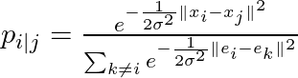
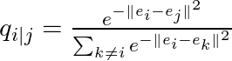
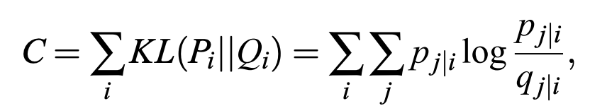
Stochastic Neighborhood Embeddings
A mixture of global and local approaches
Define:
The loss is given by:
Notes:
t-SNE differs from PCA by preserving only small pairwise distances or local similarities whereas PCA is concerned with preserving large pairwise distances to maximize variance
##in Pi the normalization should be with X_i and X_k. (e for embedding)
So Pi is the original space, and Qi after embedding, and then we use KL-divergence for every point.
Large sigma-wont differ from point to point. On the other hand, a very small sigma will most likely give the best result to the closest point.

Slide 21
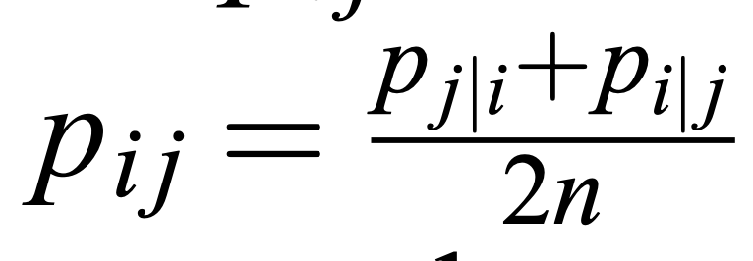
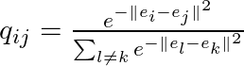
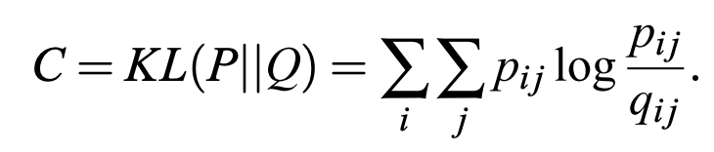
Symmetric SNE
SNE is not symmtric, but easily fixed
Notes:
Not Symmetric if we define matrix such that pij is the ith row and jth column. intuitively, this is more of a score to each pair of points, rather then actual probabilities (although positive and sums to one)
Qij is symmetric

Slide 22
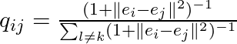
tSNE: Symmetric SNE with Student’s t
The Gaussian distribution makes far embedding decay too fast
Replace with Student’s t
Notes:
The problem was weights for far away points were too low too fast.

Slide 23
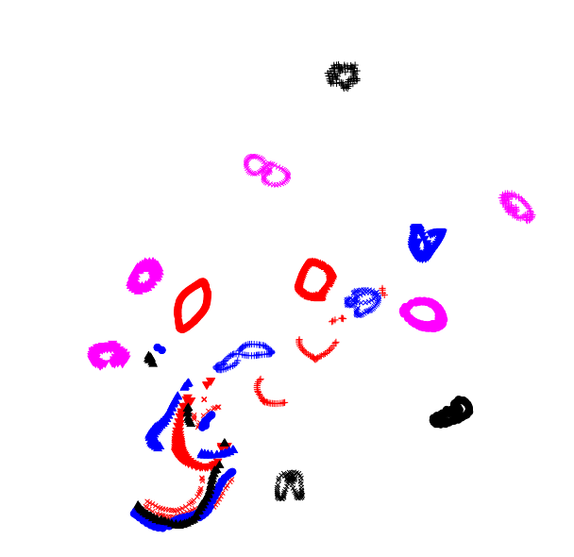
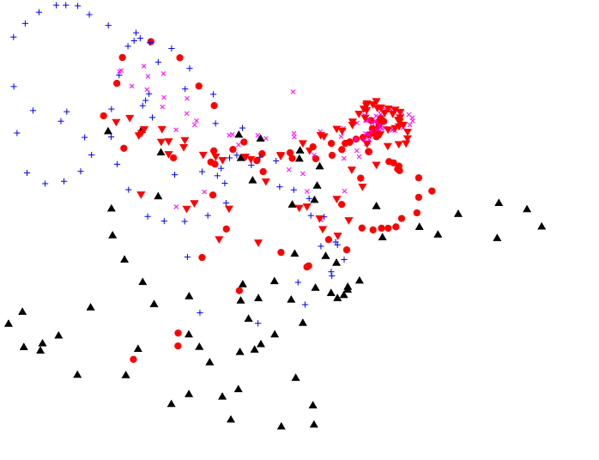
tSNE is Great for Visualization
Combines global and local structure
Comarison to local method LLE:

Slide 24
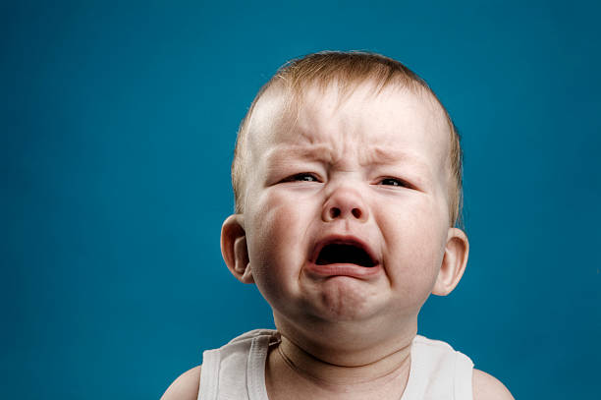
Issues with Classical Methods
What to do with test samples?
Is computing neighbors with L2 really a good idea?
Not really suitable for high d embeddings? (why?)
Classically, local methods did not work really well (t-SNE did in low d)
Notes:
When the data is high-dimensional, L2 doesn’t work as good.
These methods work well mainly for visualization.

Slide 25

Two Modification are All You Need
Modern method only modify two aspects
Mapping from x to e through a parametric function (e.g. deep nets)
Neighbors generated, not retrieved
These simple changes are enough to make a massive impact!
Notes:
Mapping instead of learning embedding for every point.
We generate neighbors, instead of looking for them.

Slide 26
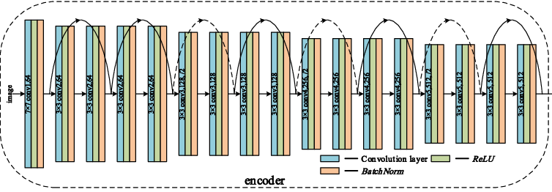
Amortizarion
Classical method optimized all embeddings directly
Cannot generlize to new samples
Prone to overfitting for large d
Modern methods learn the mapping, this solves the issues
Typically a ResNet or Transformer (like anywhere else In the course)

Slide 27
Augmentations
Local methods want similar samples to have similar embeddings
What is similar? L2 distance is terrible at high d
Idea: let user decide which variation is not important
For sample: generate samples that differ in unimportant aspects

Slide 28
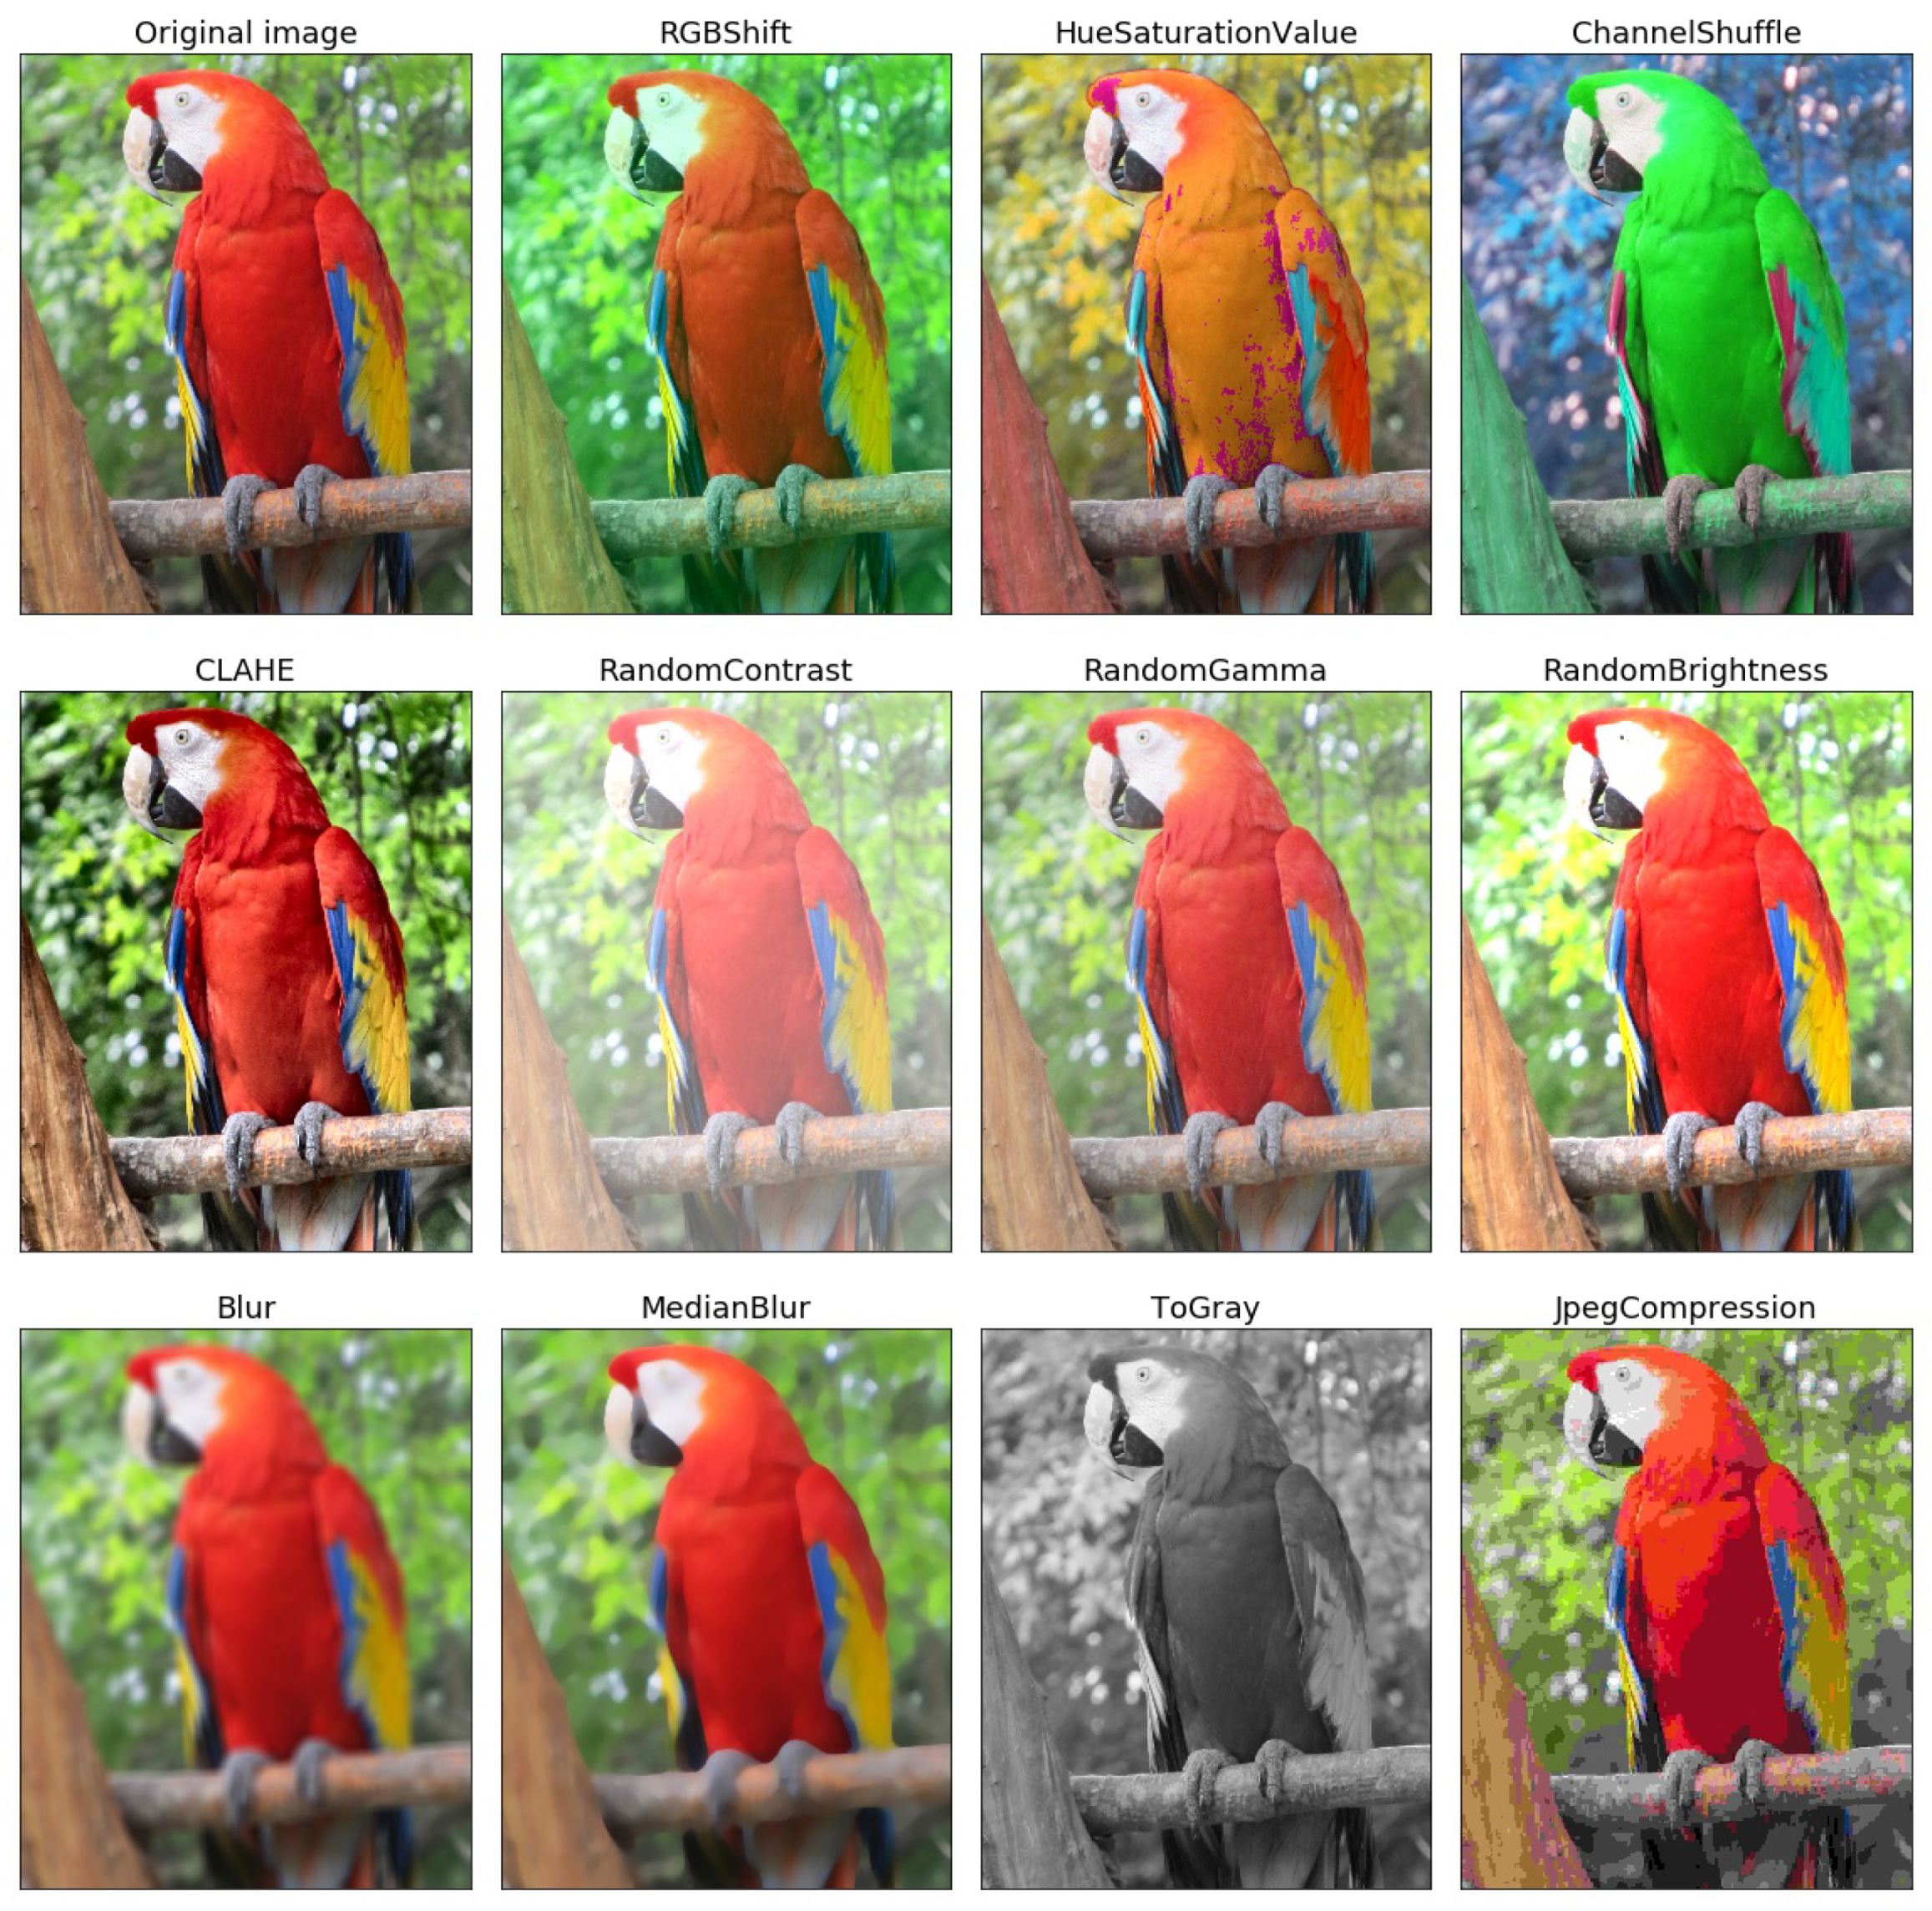
Examples of Image Augmentations

Slide 29

Augmentations: the Good and the Ugly
Good:
Can model much more semantic variation than L2
Does not require kNN search
Bad:
Need to know what variation is not important
Need to be able to sample such augmentations (when is that hard?)
Notes:
Sometimes its difficult to augment, for example, if we want to be invariant to age, or identity.

Slide 30
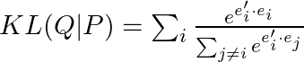
Contrastive Learning – SNE Interpretation
Augment image x_{i}
Compute probability of augmented image to belong to each image
Embeddings unit normalized
Groundtruth p_{i|j} is now 1-hot
Notes:
Intuition – when altering images, we keep the semantic, so we “enforce” the embedding to be close when the semantic is close.

Slide 31
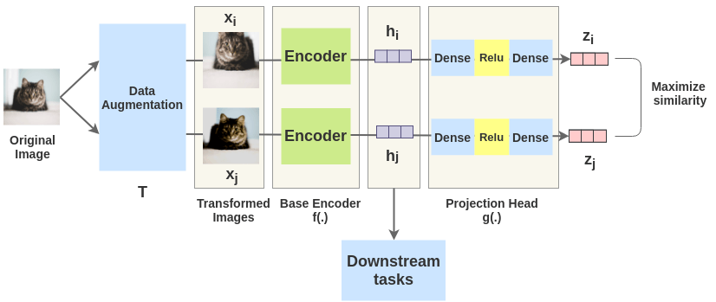
Contrastive Learning – Classifier Interpret.
Define each image x_{i} as a class
All augmentations of x_{i} belong to class I
Train a classifier to map augmented image to the correct class
In practice, we subsample the denominator for faster runtime

Slide 32
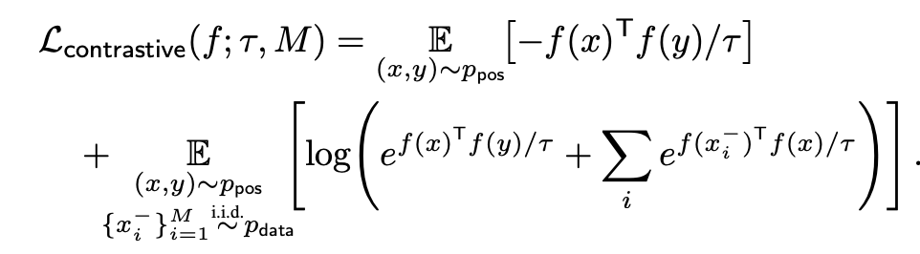
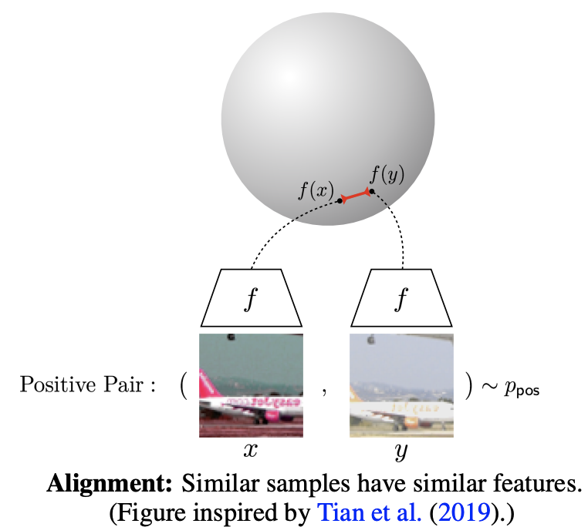
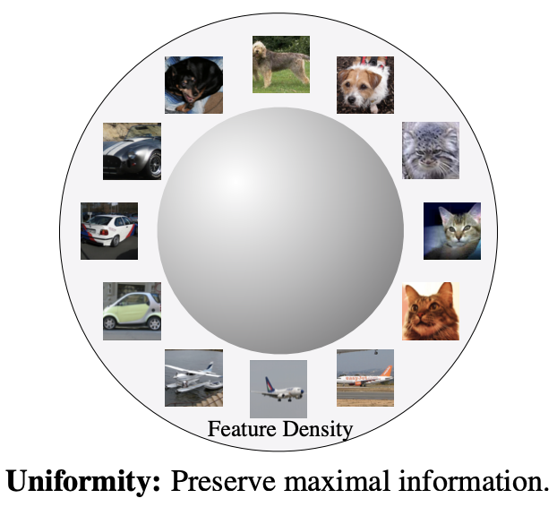
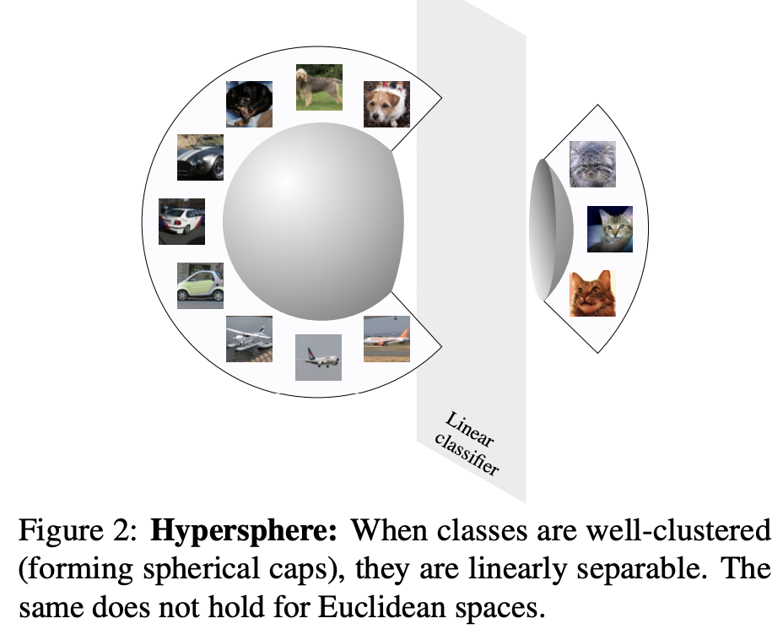
Intuition
Objective:
Augmentations fall in the same position
Feature hypersphere unifromly populated

Slide 33
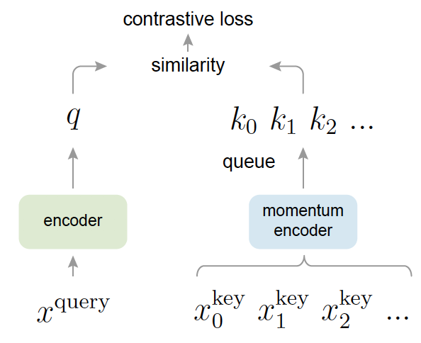
MOCO
Tricks to reduce memory requirements
Do not calculate embeddings for every batch
Instead, keep the values of all embeddings in memory
Momentum encoder ensure that embeddings change slowly

Slide 34
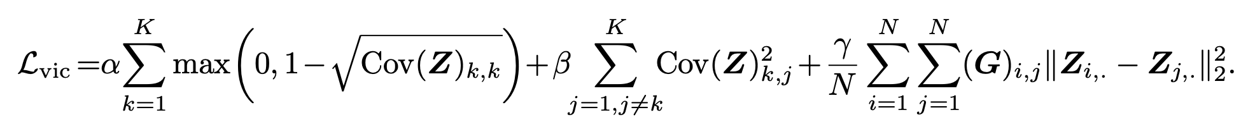
VICReg: Modern Laplacian Eigenmaps
Another method by Lecun
This one is basically laplacian eigenmaps with augmentations

Slide 35
Classical Idea: CCA
Canonical Correlation Analysis – CCA
Idea: given two views of the same data, learn common feature space
Example: image and video descriptions of event
Criterion: assume the features are x_{i} and y_{i} learn functions f and g s.t.:
Corr(f(x_{i}),g(y_{i})) = I

Slide 36
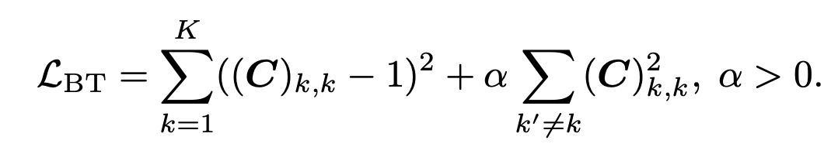
Barlow Twins: CCA with Augmentations
We denote each sample xi and its augments x’_{I}
Learn function f s.t.
Corr(f(xi),f(x’_{i})) = I
Does not really depend on batch size

Slide 37
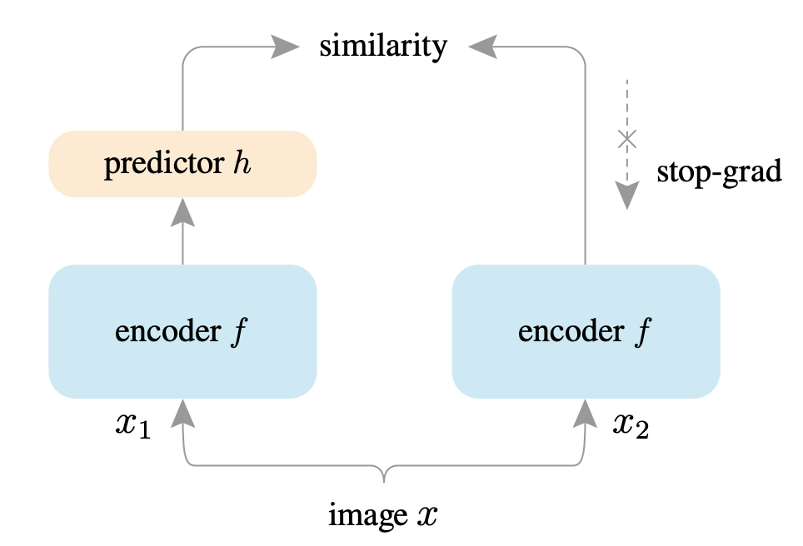
SimSiam: No Negative Samples
Exploring Simple Siamese Representation Learning, Chen and He, CVPR’21
Main idea: drop the negative samples, fix one view

Slide 38
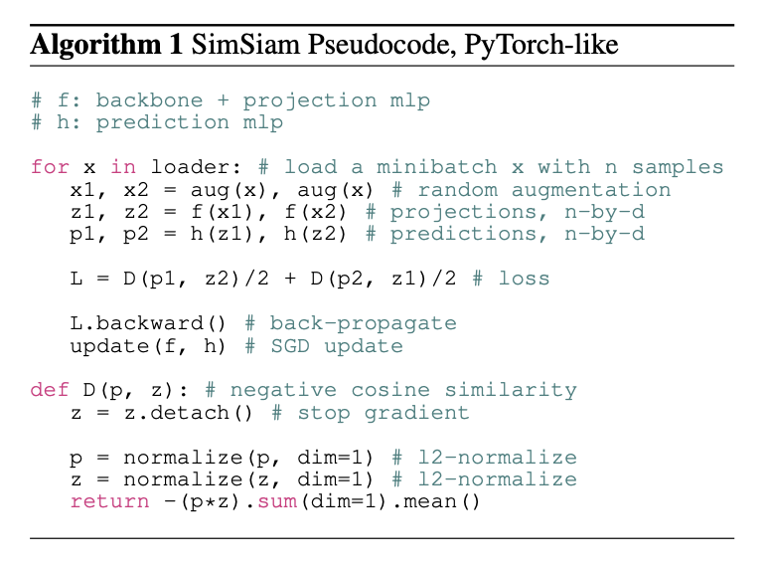
SimSiam Idea
Extract features from two augmented views
Learn predictor network to predict one from from the other

Slide 39
Multi-Modal Supervision
Self-supervised learning needs distance guidance
So far, augmentation – generative method
Sometimes better free supervision exists
Internet is full of (image, text caption) pairs
Idea: replace or extend guidance to SSL methods using this

Slide 40
CLIP: ML Trick
Double contrastive learning
One contrastive loss predicting the correct image given the caption
One contrastive loss predicting correct caption given image

Slide 41
CLIP: DL Trick
CLIP by OpenAI implements this ideas
DL trick: train different encoders for the image and text
Image encoder can be ResNet or ViT
Text encoder is a standard trasformer
Train on lots (300M pairs) of data – there are now much bigger models

Slide 42
Masked Autoencoding
Create hard labelled task for free
Example: for a sentence, remove some word. Task is to predict word given the rest of the sentence.
Very simple, but effective representation learner
Similarly to AR models, here we estimate:

Slide 43
BERT
Given sentence, remove word then learn to predict it
A representation succesful at this task must be very informative
Technical details:
Use transformer
Replace of 15 of tokens:
80% prob replace by “mask” token
10% replace by wrong word
10% word unchanged

Slide 44
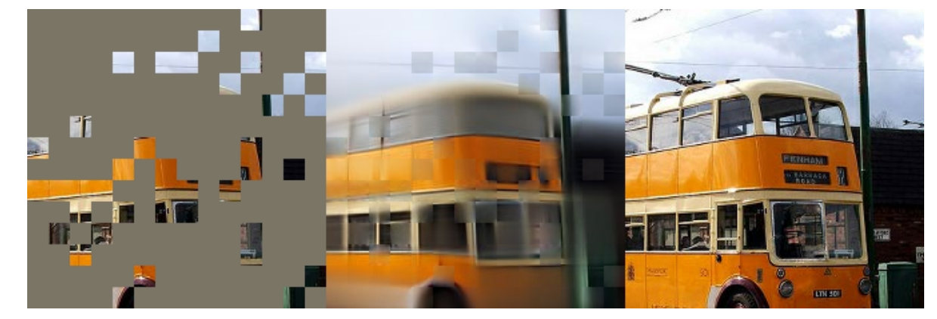
Masked Autoencoders
Idea: mask out most of the image, and try to reconstruct it
Kaiming He and other FAIR team

Slide 45
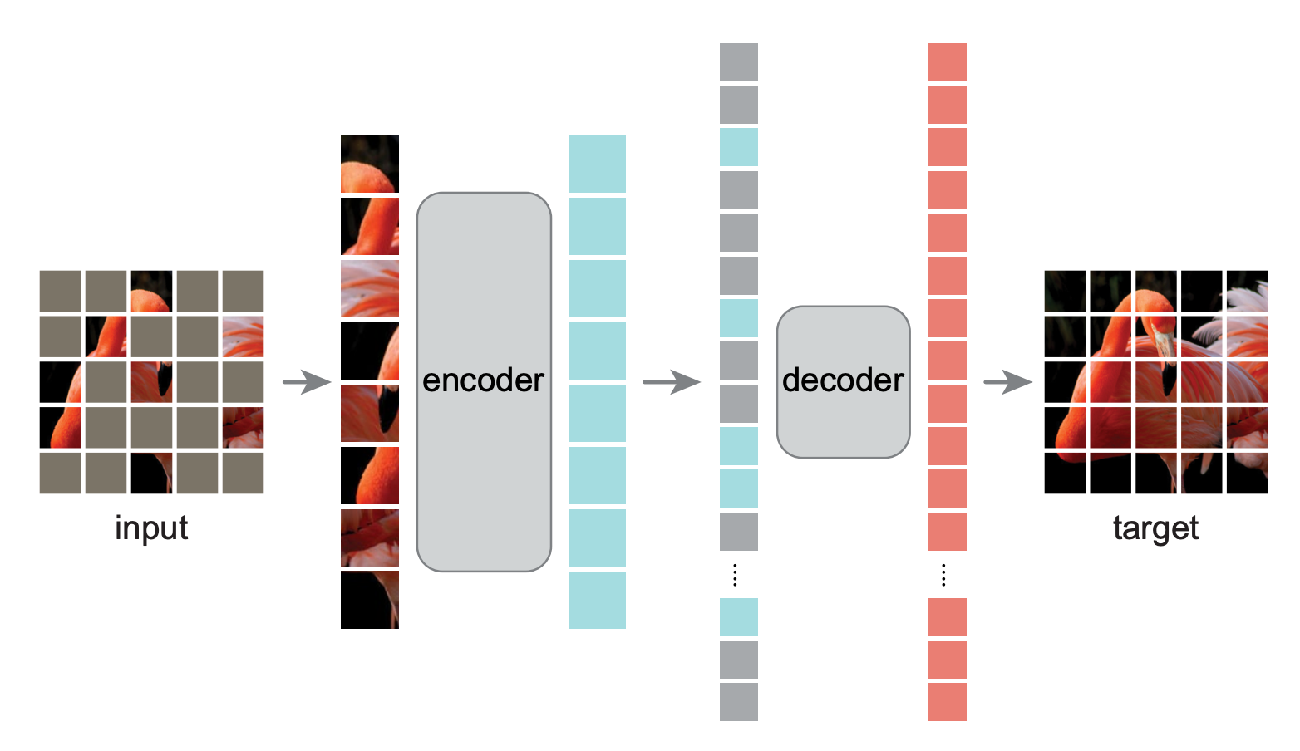
Architecture
Transformer encoder only operates on visible patches
Decoder operates on both visible and masked token
Reconstruction loss

Slide 46
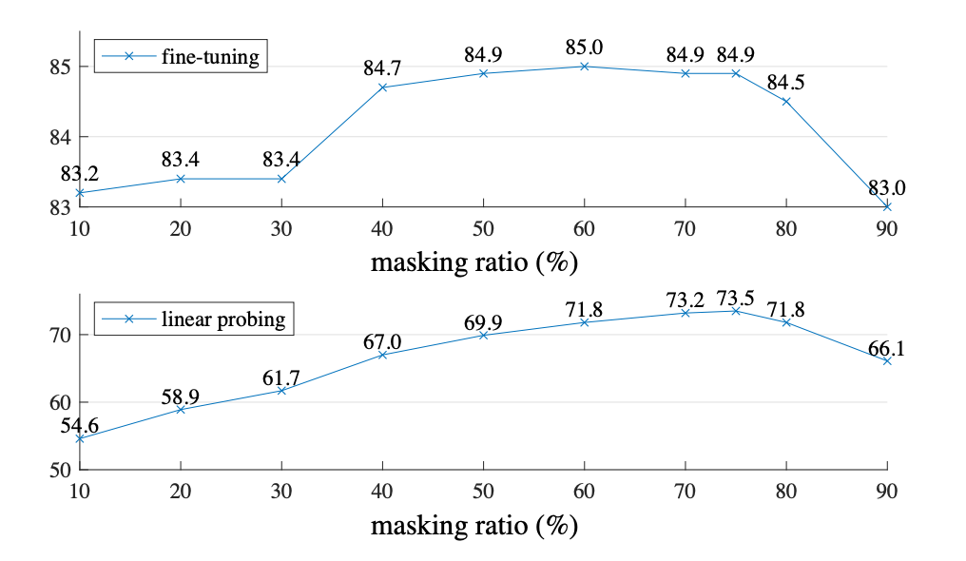
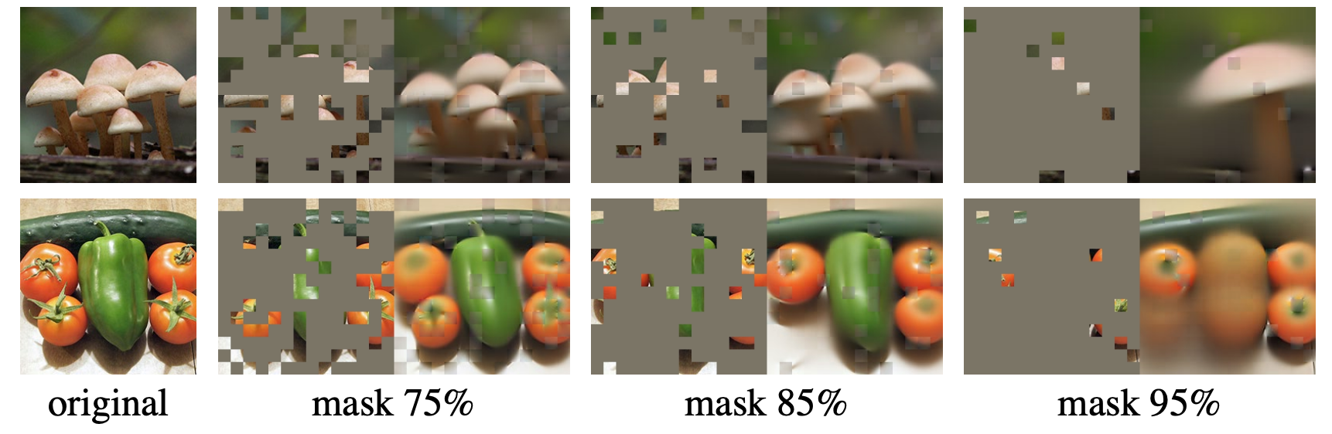
High Masking Ratio
Images are more sparse than NLP
Masking of 75-85% vs 15% in BERT
For video, ratios are around 95%!

Slide 47
Other Findings
Working on raw pixels is as good as more complex ideas
Random masking at least as good as other ideas
Results are much better than contrastive methods for fiinetuning
Results are not as good as contrastive for linear probing/ knn
Great scaling behavior to very large transformers
Operates well even on small datasets (10k images)

Slide 48
BEIT
BERT for images
First tokenize image using some vector quantizer
Then run discrete BERT on the discrete image representation
Results in line with MAE

Slide 49
Overview of Pros and Cons of Representations
Contrastive
MoCo
Barlow Twins
SimSiam
VICReg
BERT
BEIT
MAE

